Slide 1
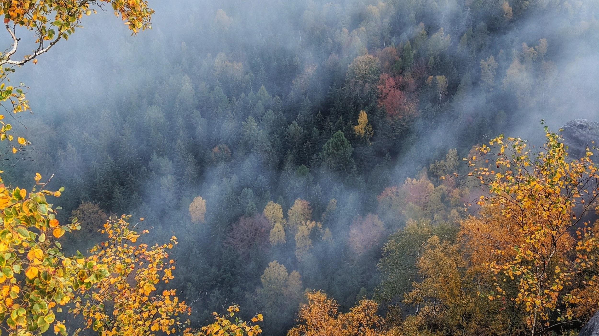
ABORIGINAL FIRE MANAGEMENT
We will explain how the use of fire by traditional Aboriginal people affects ecosystems.
Notes:
Insert cover image and use transparency settings to fade image.

Slide 2
Do not delete this slide.
This slide is designed so that you can copy the prompt box you need and insert it into your slides.
This slide is hidden and will not be included when presenting your lesson.
TRACK WITH ME
VOCABULARY
1 -
HINT
Students, remember….
CHECK FOR UNDERSTANDING
READ WITH ME
TEACHER CUE
MAKE THE CONNECTION
Students, you already know….
EXTENSION

Slide 3
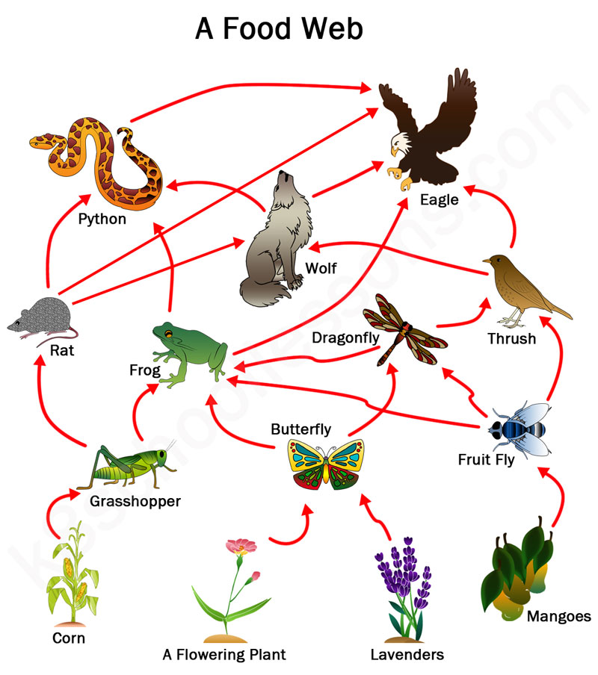
Draw two individual food chains from this food web.
Name one producer in this food web
Name one primary consumer in this food web.

Slide 4
Repeat the opposite word/phrase.
PRODUCERS
PRODUCE THEIR OWN FOOD

Slide 5
Repeat the opposite word/phrase.
PRIMARY CONSUMERS
EAT PRODUCERS

Slide 6
Repeat the opposite word/phrase.
DETRIVORE
FEEDS OF DEAD MATERIAL

Slide 7
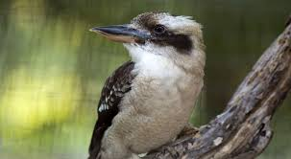
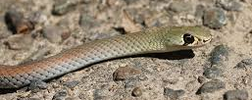
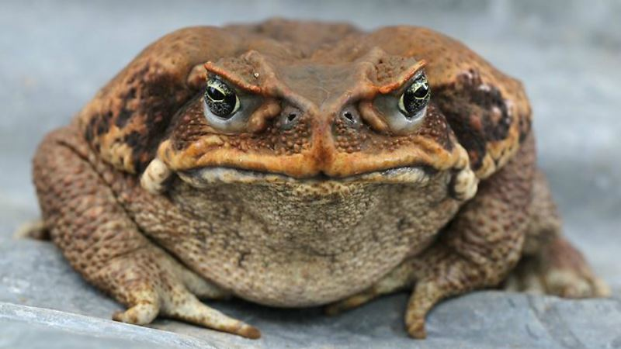
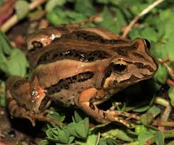
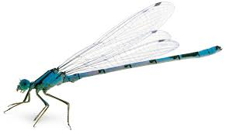
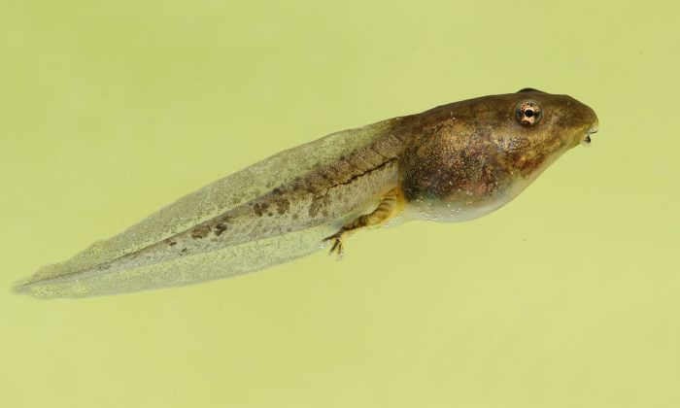
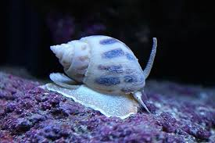
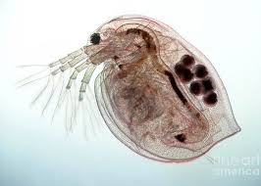
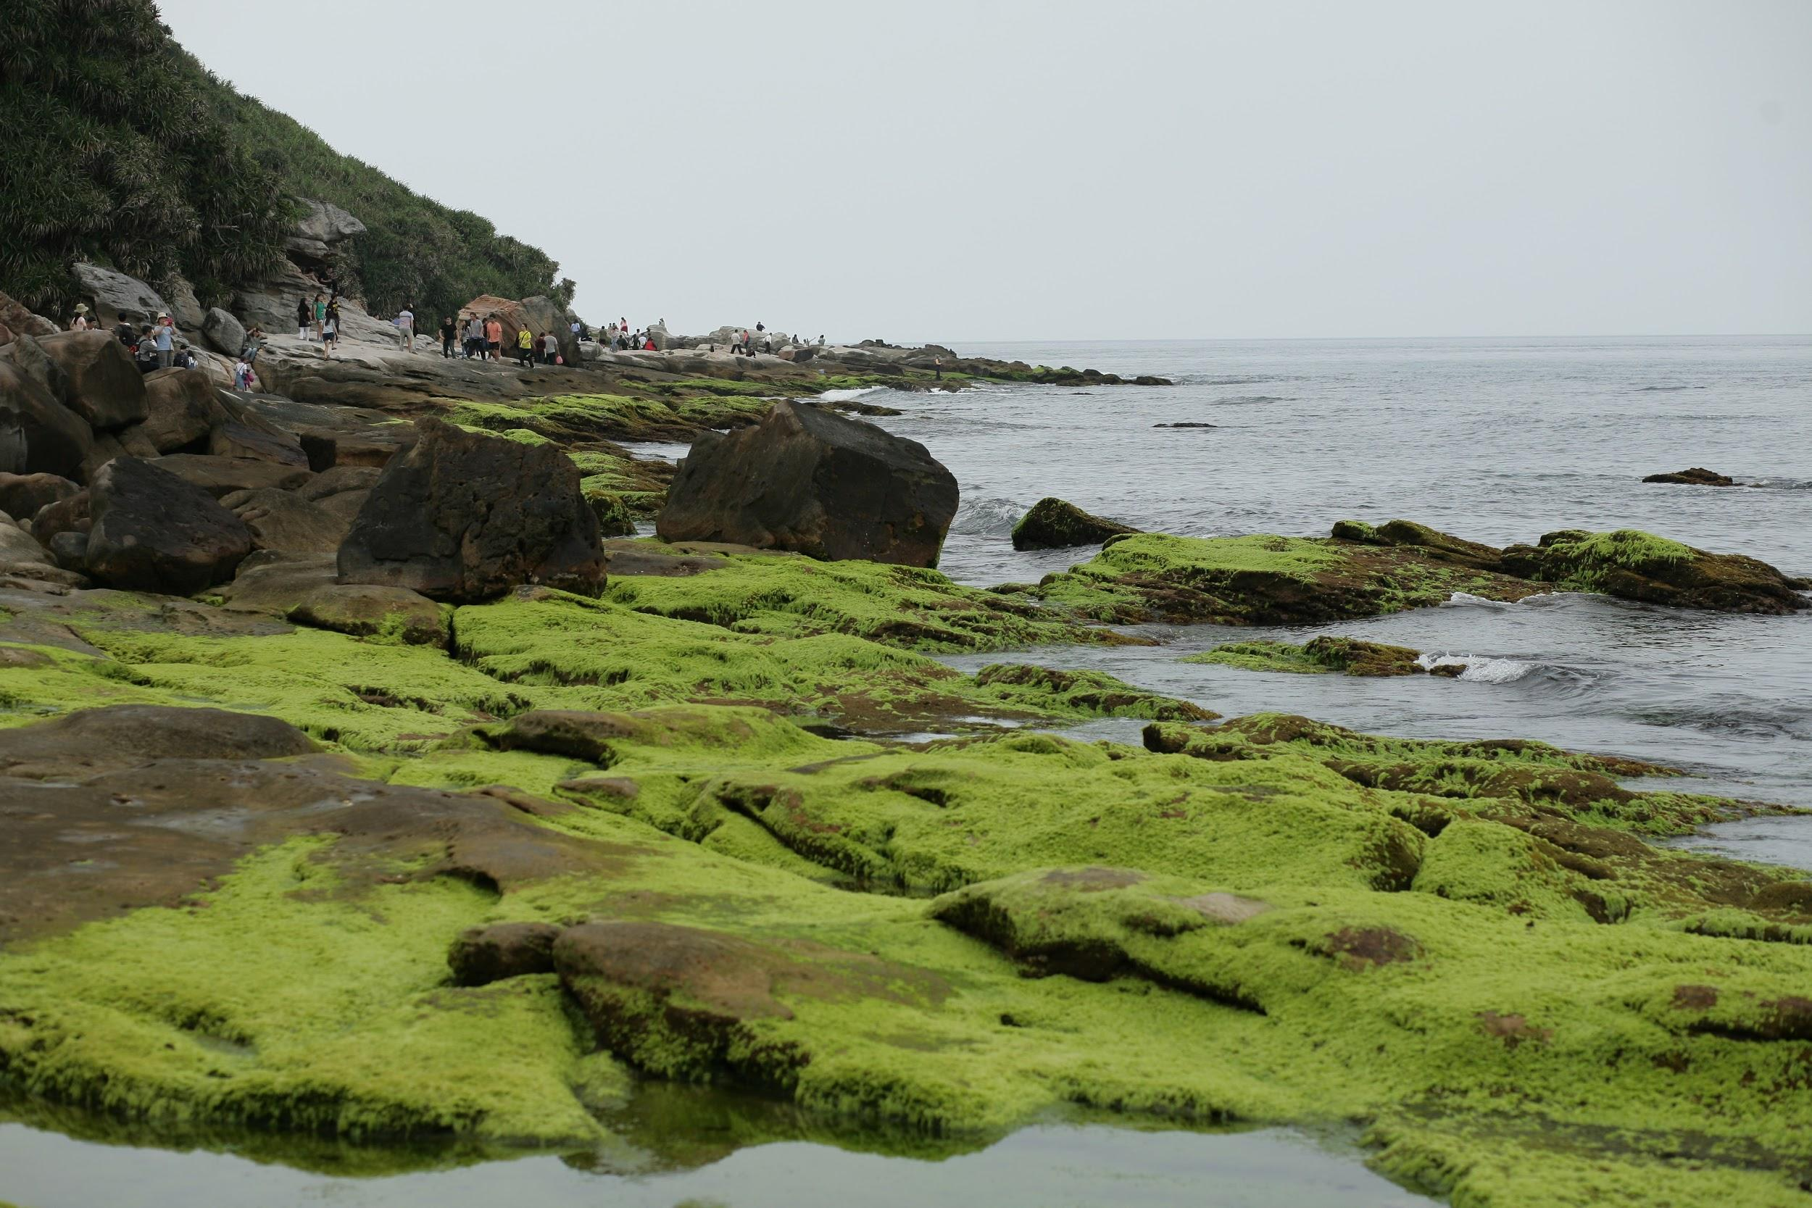
HINT
Competition Predation
What Impact does introducing the cane toad have on the kookaburra and snake.
Cane toads are extremely poisonous – predators who attempt to eat them will usually become very ill and in some cases die.
Kookaburra
Snake
Native frog
Damselfly
Tadpole
Aquatic snail
Daphnia
Algae

Slide 8
True or False:
A peacock is in the Kingdom Animalia _______
Both Emu’s and Peacocks are in the class Aves ______
Birds are invertebrates _______
Scientific names are written in Spanish ________
NUMBER | A: Peacock | B: Emu
1 | S: Pavo cristatus | K: Animalia
2 | P: Chordata | F: Casuariidae
3 | K: Animalia | G: Dromaius
4 | O: Galliformes | O: Casuariiformes
5 | C: Aves | C: Aves
6 | G: Pava | P: Chordata
7 | F: Phasianida | S: Dromaius novaehollandiaes

Slide 9
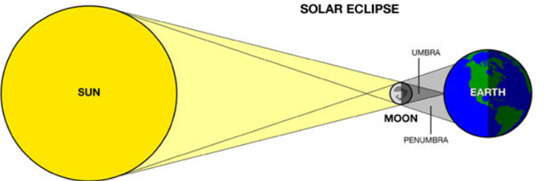
Is this a solar or lunar eclipse?
S-M-E

Slide 10
We will explain how the use of fire by traditional Aboriginal people affects ecosystems.
TRACK WITH ME
READ WITH ME
We will describe the burning practices by traditional Aboriginal people.
We will use local examples of how ecosystems benefit from fire.
DECLARE THE OBJECTIVE
Read the learning objective to your partner.
Notes:
Learning Objectives contain concepts (nouns, big ideas), skills (verbs, measurable behaviours) and sometimes context (restricting or targeting conditions).
●Example: Students will be able to describe the concept of density and apply it to floating and sinking.
●
Success criteria are specific measurable outcomes that if met mean that the student has met the learning objective.
Examples:
•Students will be able to compare densities of substances using mass and volume.
•Students will be able to identify whether a solid or liquid will float or sink in a liquid based on their densities.

Slide 11
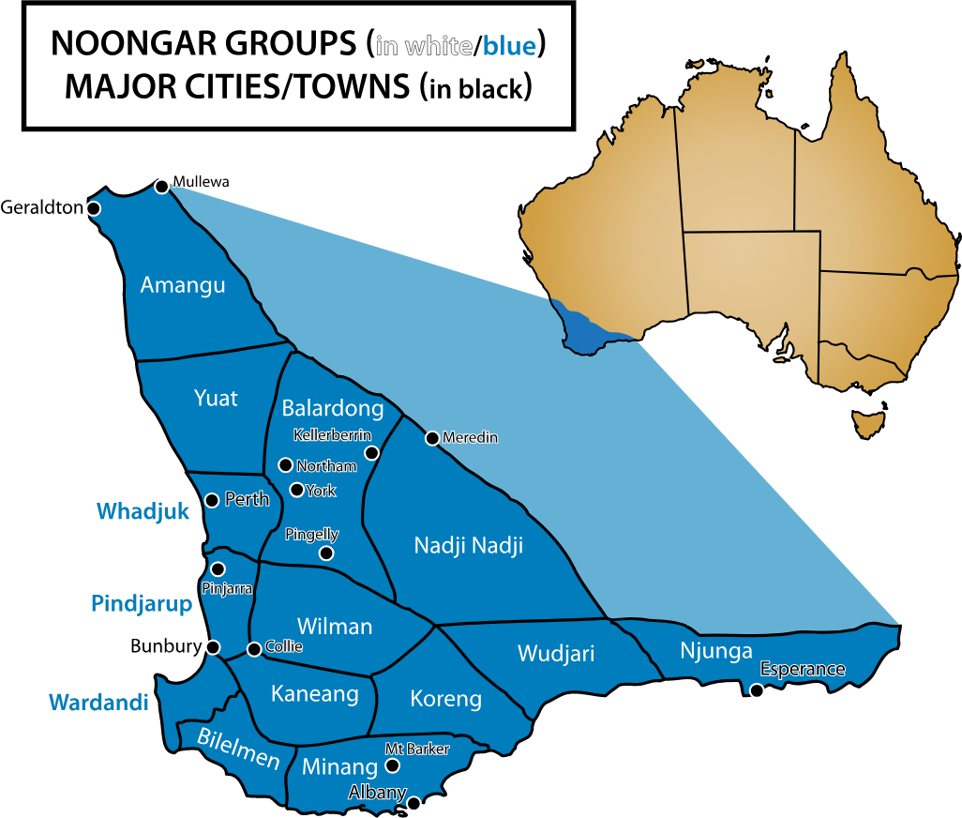
We will explain how the use of fire by traditional Aboriginal people affects ecosystems.
The Noongar people have lived in the south-west of Western Australia for over 45,000 years.
In Noongar country there are 14 different areas with 14 different language groups.
Name one Noongar area on the map.

Slide 12
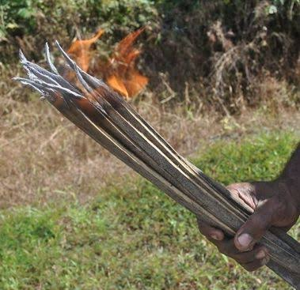
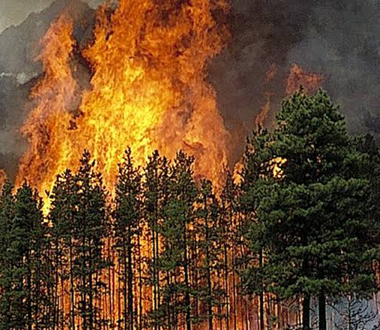
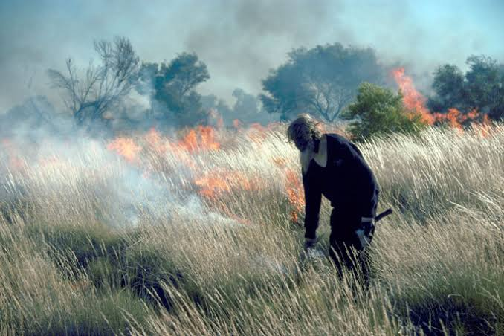
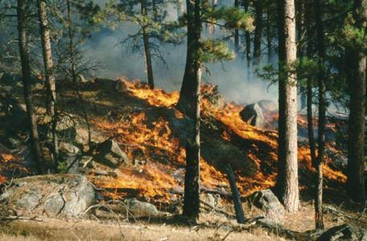
We will explain how the use of fire by traditional Aboriginal people affects ecosystems.
CHECK FOR UNDERSTANDING
Using the pictures, what is the difference between low intensity and high intensity fires?
For the last 50,000 years, Australia’s Indigenous communities care for country (Boodja/Booja) by using fire (Karla) to manage plant growth and animal populations.
Traditional burning methods called fire stick farming (Karlmarta /Karlmoorl) was used to create regular low intesity₁ fires.
Aboriginal people move through the bush (marlak) with a fire stick to clear specific scrub, trees and bushland areas with fire in a mosaic pattern every three to four years.
High intensity fire
Karlmarta farming methods
Low intensity fire
VOCABULARY
1 - small, prescribed burns

Slide 13
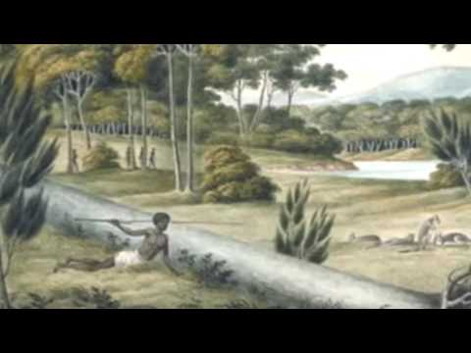
We will explain how the use of fire by traditional Aboriginal people affects ecosystems.
CHECK FOR UNDERSTANDING
What was one effect on the land of traditional firestick farming?
TEACHER CUE
Three minute video with an example from Eastern States

Slide 14
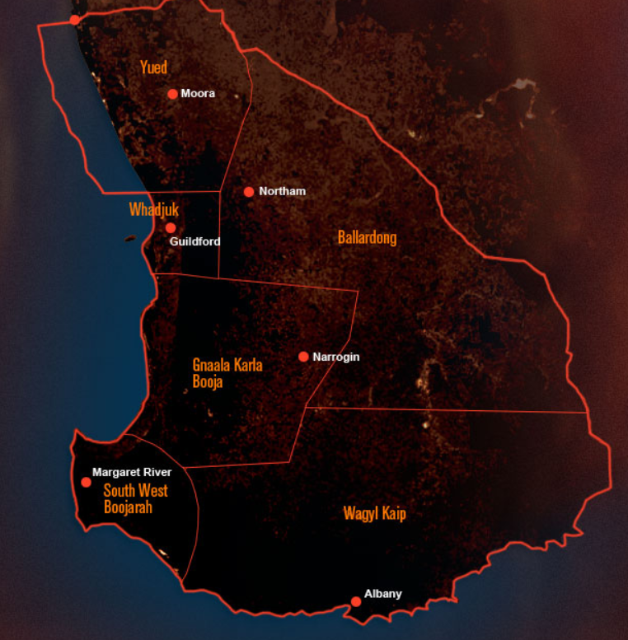
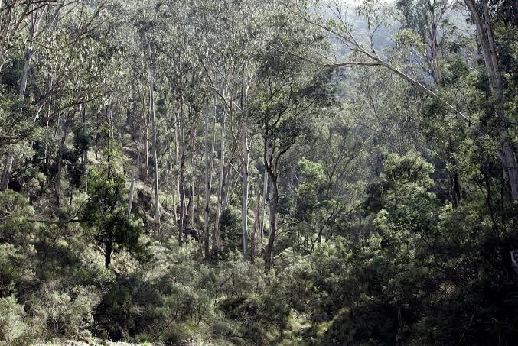
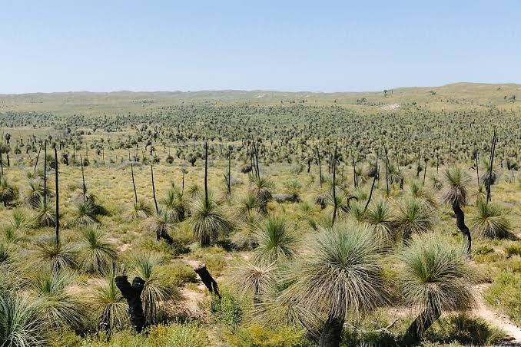
We will explain how the use of fire by traditional Aboriginal people affects ecosystems.
CHECK FOR UNDERSTANDING
What is the difference between the photos of thick bush and grassland?
In the Perth region, Aboriginal people used knowledgeable fire stick farming as a traditional method to manage the bush in the following areas.
South West Boojarah, Whadjuk and Ballardong.
Bush (marlak) burnt with the firestick method changed from thick unmanageable bushland into productive grassland and heathland.

Slide 15
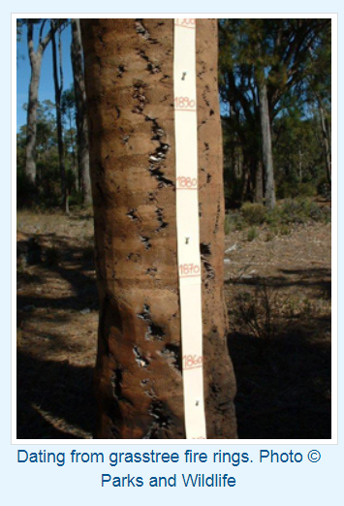
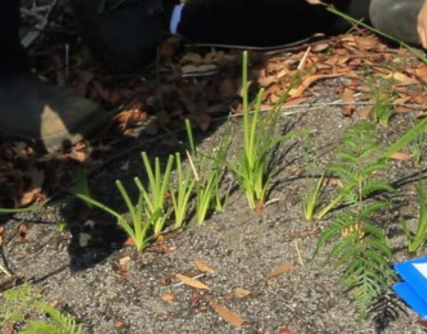
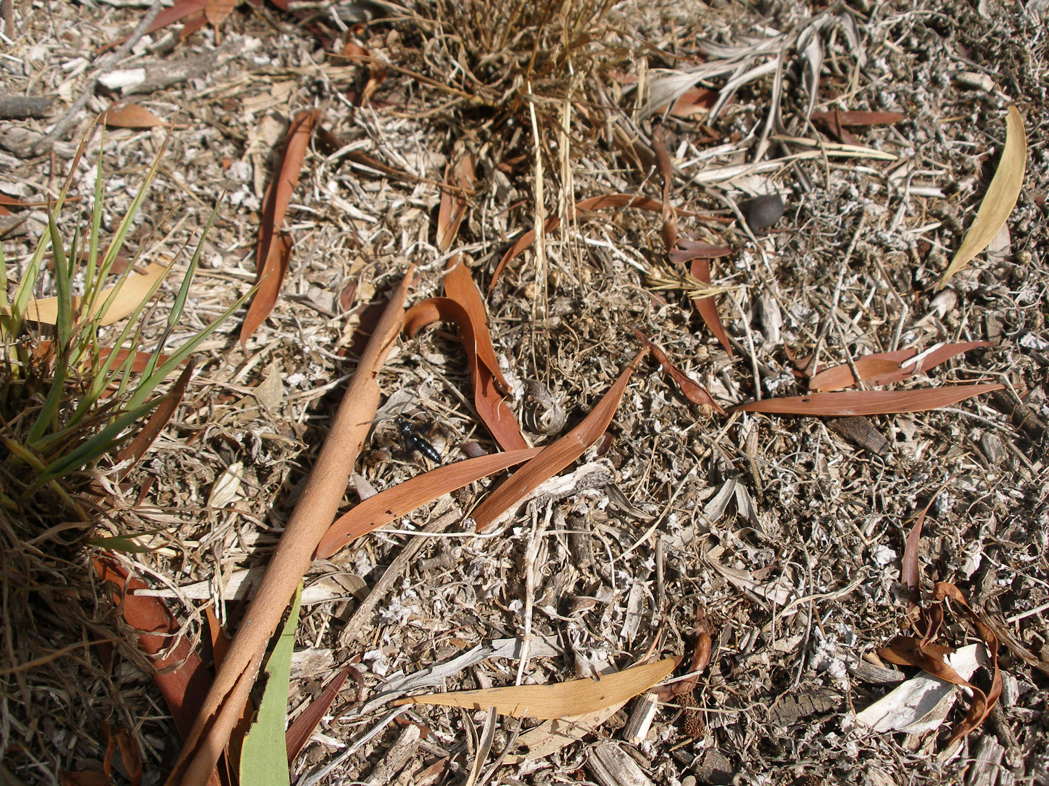
We will explain how the use of fire by traditional Aboriginal people affects ecosystems.
CHECK FOR UNDERSTANDING
What would happen to country if there was no firestick farming over time? In your answer refer to plants, animals or safety.
Regular firestick farming had a positive effect on the ecosystem.
Plants
New seeds and shoots regrew in cleared areas.
Banksia (mangatj seeds only grew after fires.
Burnt plants and ash increase nutrients in the soil for plants to grow.
Soil becomes fertile for bush food such as potatoes.
Animals
Native animal populations increased as a result of new shoot growth.
A wide range of animals moved into new area due to space and new food in grassland.
Safety
Reduced the buildup of leaf litter, which causes dangerous high severity fires.
New growth after a traditional fire
Leaf litter, bark and plant material

Slide 16
We will explain how the use of fire by traditional Aboriginal people affects ecosystems.
CHECK FOR UNDERSTANDING
Did fire stick farming create dangerous fires?
Answer the following questions in full sentences.
HINT
Students, remember…. Traditional burning methods called fire stick farming (Karlmarta /Karlmoorl) was used to create regular low intesity₁ fires. Bush (marlak) burnt with the firestick method changed from thick unmanageable bushland into productive grassland and heathland. Plants: New seeds and shoots regrew in cleared areas and ash helps new plants grow. Animals: Native animal populations increased Safety: Reduced the buildup of leaf litter.
Does fire stick farming use high intensity or low intensity fire practices?
How do Aboriginal people use a fire stick (Karlmarta /Karlmoorl) to create a fire.
Give one positive effect on fire stick farming for the following parts of the ecosystem
Plants
Animals
Safety

Slide 17
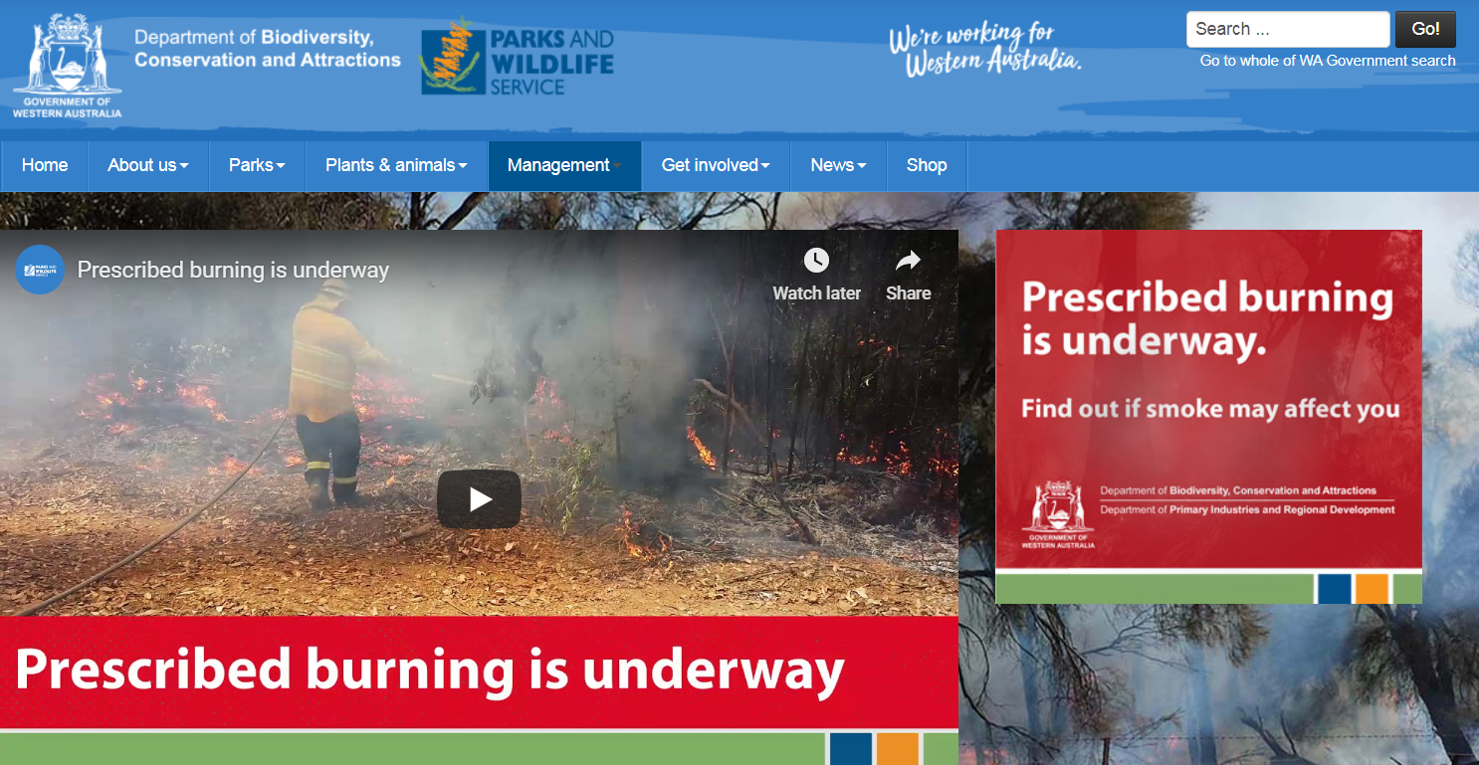
We will explain how the use of fire by traditional Aboriginal people affects ecosystems.
Currently, Western Australia’s prescribed burns are managed by the Department of Biodiversity, Conservation and Attractions (DBCA) and Parks and Wildlife services (government).
Prescribed burns occur in Autumn and Winter when the weather is cooler.
Prescribed burns use a similar method of low intensity fire but are not conducted using Aboriginal fire stick knowledge.
CHECK FOR UNDERSTANDING
Why are prescribed burns not carried out in summer?

Slide 18
We will explain how the use of fire by traditional Aboriginal people affects ecosystems.
CHECK FOR UNDERSTANDING
What could be some issues in the ecosystem if fire stick farming is not carried out every 3 to 4 years?
Aboriginal people have a very knowledgeable understanding of country, plants and animals. They manage the ecosystem with fire stick farming in a very effective way. This benefits plant growth and animal population increase.
Plants
New seeds and shoots regrew in cleared areas.
Banksia mangatj seeds only grew after fires.
Burnt plants and ash increase nutrients in the soil for plants to growth.
Soil becomes fertile for bush food such as potatoes.
Animals
Native animal populations increased as a result of new shoot growth.
A wide range of animals moved into new area due to space and new food in grassland.
Safety
Reduced the buildup of leaf litter, which causes dangerous high severity fires.
New growth after a traditional fire
Leaf litter, bark and plant material

Slide 19

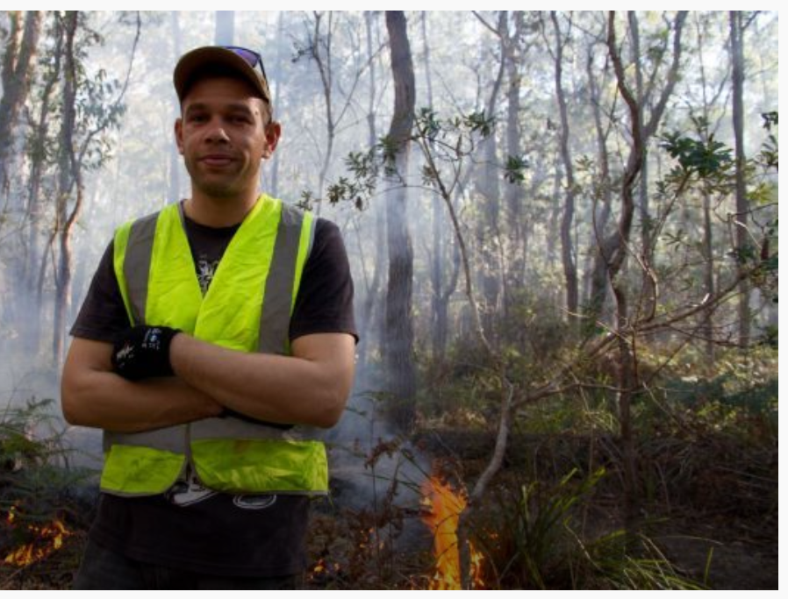
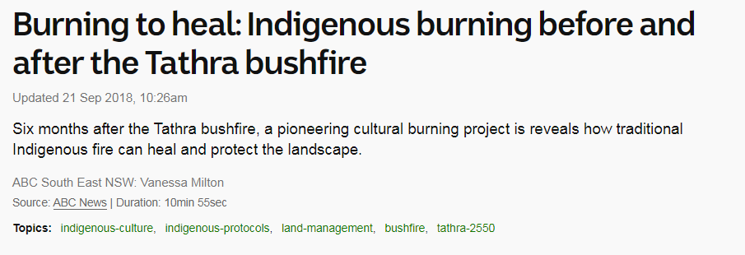
We will explain how the use of fire by traditional Aboriginal people affects ecosystems.
Watch the following 10 minute video from ABC
Write a paragraph about how fire stick farming has a positive effect on the ecosystem.
https://www.abc.net.au/news/2018-09-18/cultural-burning-before-and-after-the-tathra-bushfire/10258024
Notes:
Please include tasks/questions here rather than just referring to a worksheet. This will save on photocopying and facilitate sharing with other schools.
Try and build tasks/questions which escalate through Bloom’s Taxonomy. This will help with differentiation.

Slide 20
We will explain how the use of fire by traditional Aboriginal people affects ecosystems.
We will describe the burning practices by traditional Aboriginal people.
We will use local examples of how ecosystems benefit from fire.
CHECK FOR UNDERSTANDING
Check Success Criteria.

